Slide 1
Final project python
Duldiyev Raiymbek
Kaisarbek Ali
Tulep Zarina

Slide 2
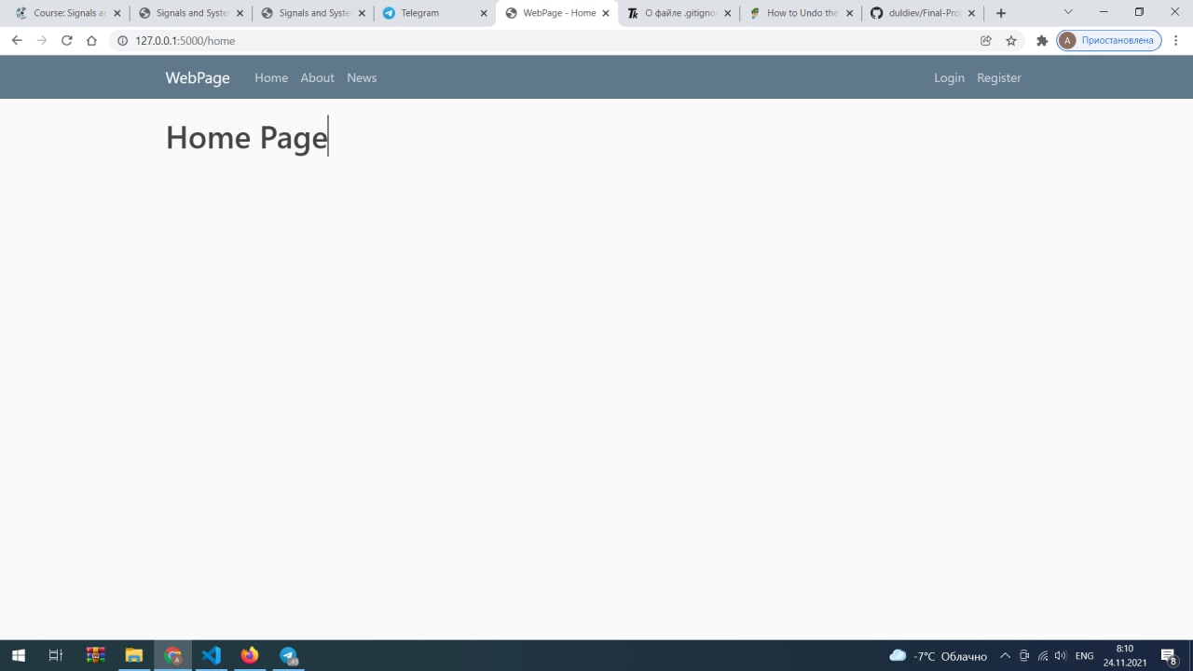

Slide 3
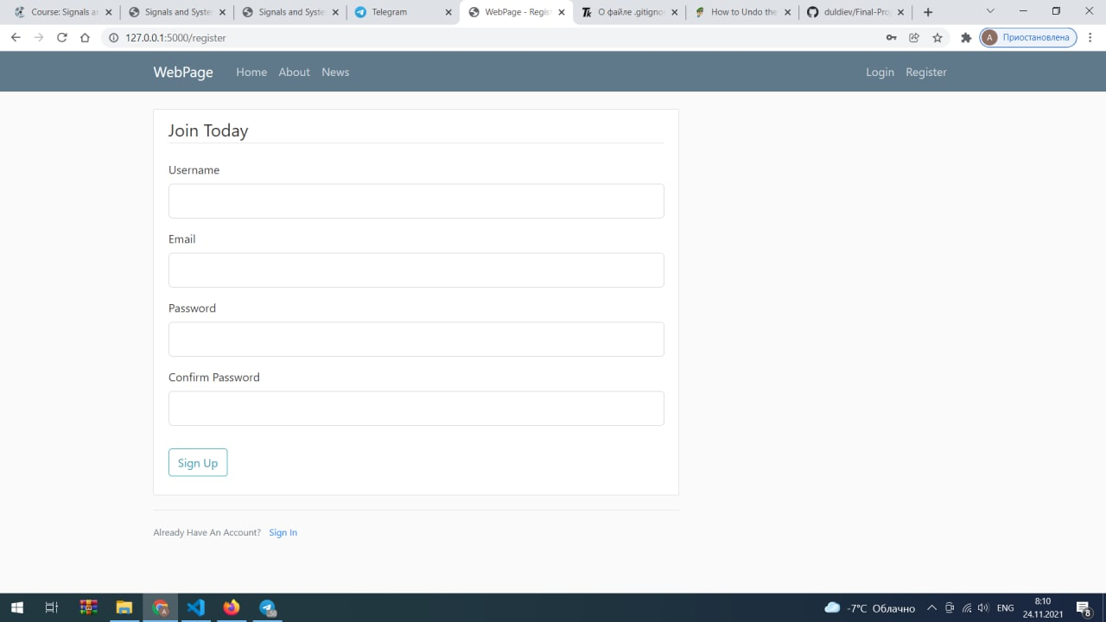

Slide 4
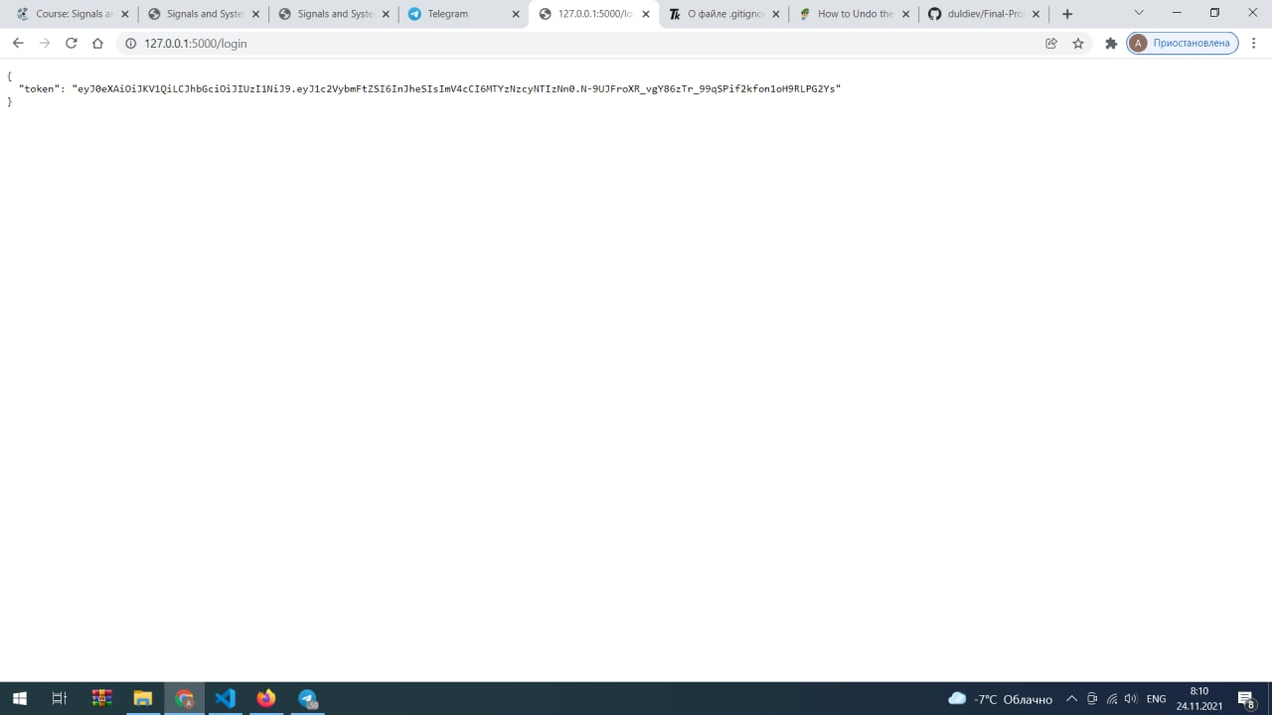
Here our token, getpost method

Slide 5
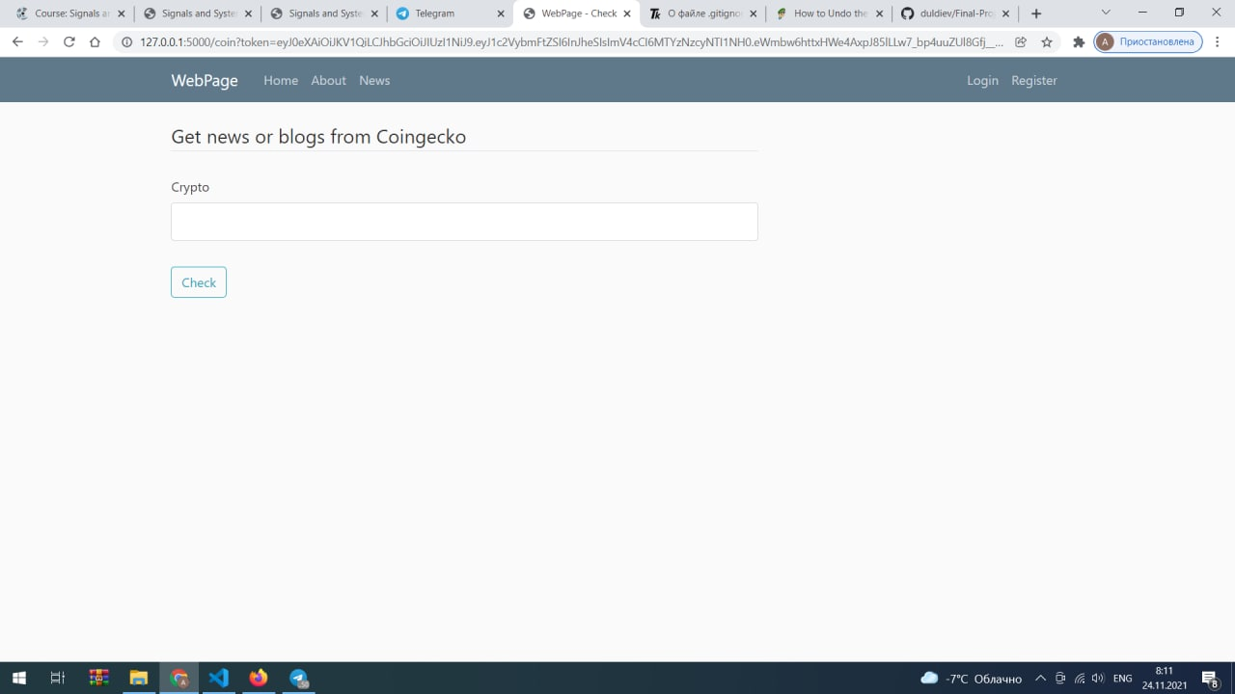
To get access we should enter token

Slide 6
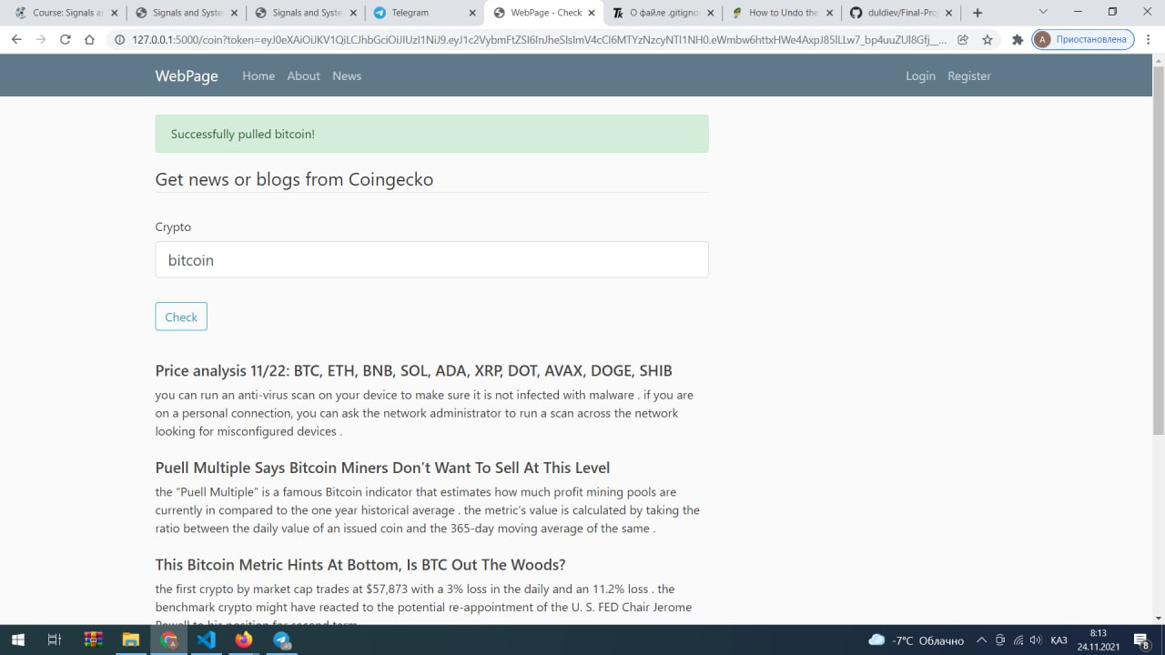
Finally we get summarized articles for each blogs

Slide 7
Thanks for your attention

